Slide 1


Get Your JAM On!
Aaron Powell
Principal Cloud Advocate
@slace | www.aaron-powell.com | aaron.powell@microsoft.com
Notes:
TEST CLICKER

Slide 2
Get Your JAM On!
Aaron Powell
Principal Cloud Advocate
@slace | www.aaron-powell.com | aaron.powell@microsoft.com

Slide 3

👋
Aaron Powell
Principal Cloud Advocate @ MS
Web Dev
Blogger
Public Speaker
@slace
www.aaron-powell.com
aaron.powell@microsoft.com
www.twitch.tv/NumberOneAaron

Slide 4

Notes:
You’re starting a new web project and you’ve decided that you want to go with Blazor WASM
Gives you all the power of a .NET environment, but the rich user experience of build a client-side web solution.

Slide 5


Notes:
You need a backend, why not give serverless a go.
Settle on Azure Functions, HTTP trigger will give you the API experience you need, code sharing can be done as it’s all .NET, scalability fits well with what you want for the expected growth of your application, without the need to handle too much infrastructure complexity.

Slide 6

Notes:
We want to deploy easily, so naturally we want a devops pipeline that when we push to our repo we’ll have our code built and deployed to the web host

Slide 7

Notes:
Speaking of hosting, what are we going to use for our hosting?
We could host on app service, but then we’d need to handle the scaling of the front-end, and still need a separate resource for Functions.
We could host on storage, but then we need CDN to handle routing, and the Functions resource.
We could host it in a container, so we can have some Kubernetes in there.

Slide 8

Notes:
What about Azure Static Web Apps?

Slide 9
Static Web Apps
Front end asset hosting
Azure Functions API
Globally distributed content
Custom domains with free SSL
GitHub integration for CI/CD
Built-in authentication with AAD, GitHub, Twitter, etc.

Slide 10
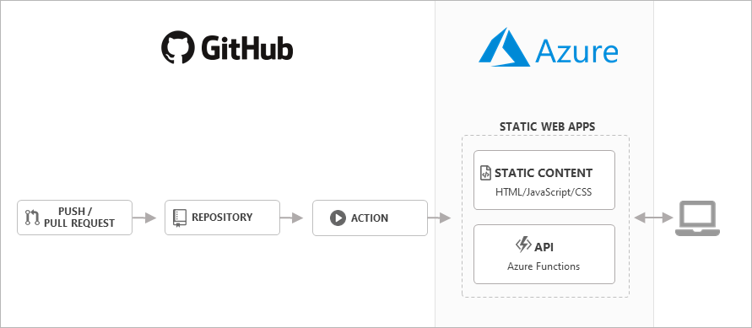
Static Web Apps
Notes:
When you create a Static Web App it provisions a GitHub Actions workflow file for you which will build and deploy your app from the branch that you specify.
It even supports setting up a staging environment from a PR, so you can view your deployed changes rather than having to do a local sync of them and setup the environment locally.

Slide 11
Demo
Build a Static Web App

Slide 12


Preview Available
Supports Blazor WASM 3.2
Auth in the works
Blazing Pizza workshop being updated
https://aka.ms/dotnetconf/swa-docs
https://aka.ms/dotnetconf/swa-learn

Slide 13

Thanks for joining!
Aaron Powell
@slace | www.aaron-powell.com | aaron.powell@microsoft.com

Slide 14









Slide 15








Slide 16








Slide 17


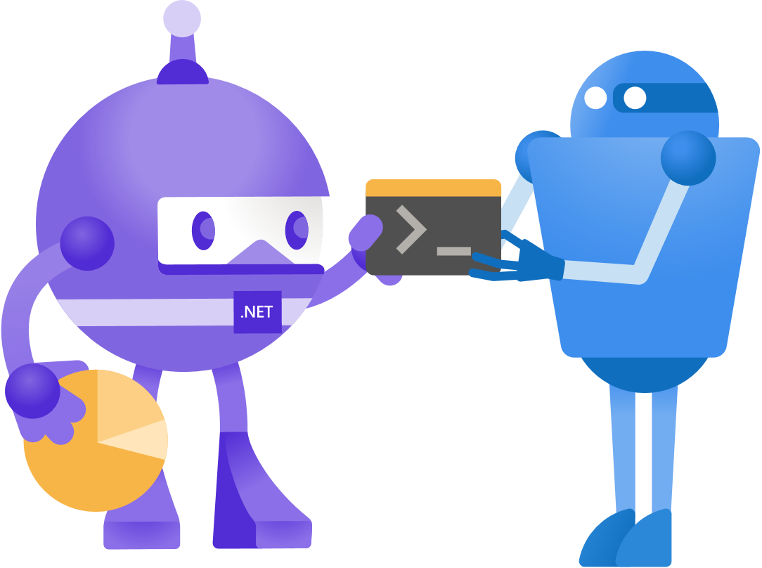






Slide 18





Slide 19


Slide 20


Slide 21


Slide 22


Slide 23


